Slide 1
How robustly can LLMs process lengthy context?
Presenter: Hanxiang Qin, Zhengguang Wang
LLMs Get Lost In Multi-Turn Conversation
How Many Instructions Can LLMs Follow at Once?
Notes:
Tip: If you want to update this template with your division or center logo, navigate to View > Slide Master and edit the template from there.

Slide 2
LLMs get Lost in Multi-turn Conversation

Slide 3
The Gap
LLMs are commonly used in a conversation way (e.g., ChatGPT, Gemini, Claude).
Real-world users often clarify their needs over several turns.
However, LLM evaluation focused on the single-turn, fully-specified setting.
This paper also argues that most multi-turn benchmarks designed each turn as a distinct subtask. They miss the key challenge of integrating information over time to solve a single, evolving problem.
Notes:
The author claim there is a gap between how models are tested and how they are used.

Slide 4
Motivation
Notes:
The core motivation for this paper is that there is a mismatch between benchmark design and real-world usage.
LLMs are commonly used in a conversation way. However, we almost exclusively benchmark them with single, comprehensive prompts.
On the left, you see the typical evaluation setup: the user provides all requirements at once, and the LLM makes one attempt.
On the right is the more realistic scenario: the user starts with a vague request, and the details are filled in over multiple turns.
This paper also argues that most alternative multi-turn benchmarks designed each turn as a distinct subtask.
They miss the key challenge of integrating information over time to solve a single, evolving problem.

Slide 5
Key Finding
Lost in conversation
An average performance drop of 39% across 6 generation tasks
A loss in Aptitude (-15%)
A significant increase in Unreliability (+112%).
Notes:
This chart is the key finding of the paper.
It plots 'Aptitude' on the y-axis against 'Unreliability' on the x-axis.
Before we move forward, let’s get the definition of 'Aptitude' and 'Unreliability’.

Slide 6
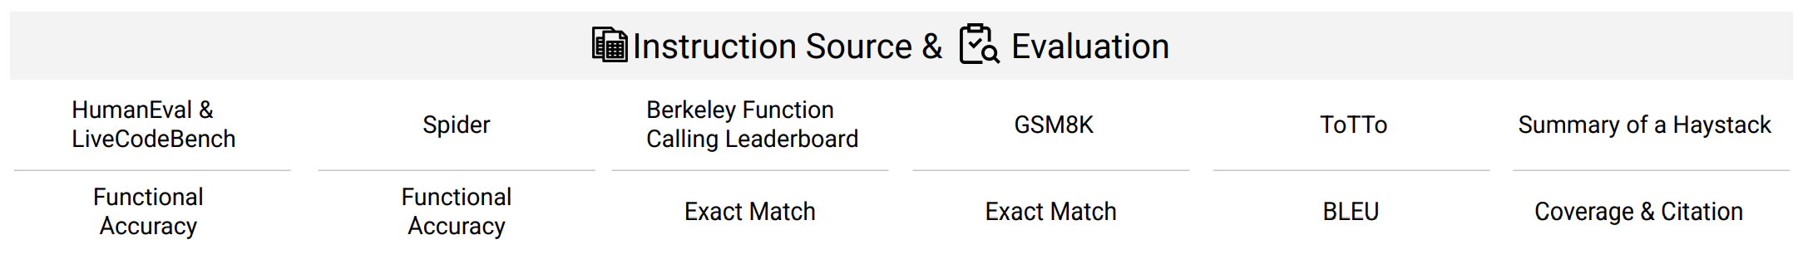
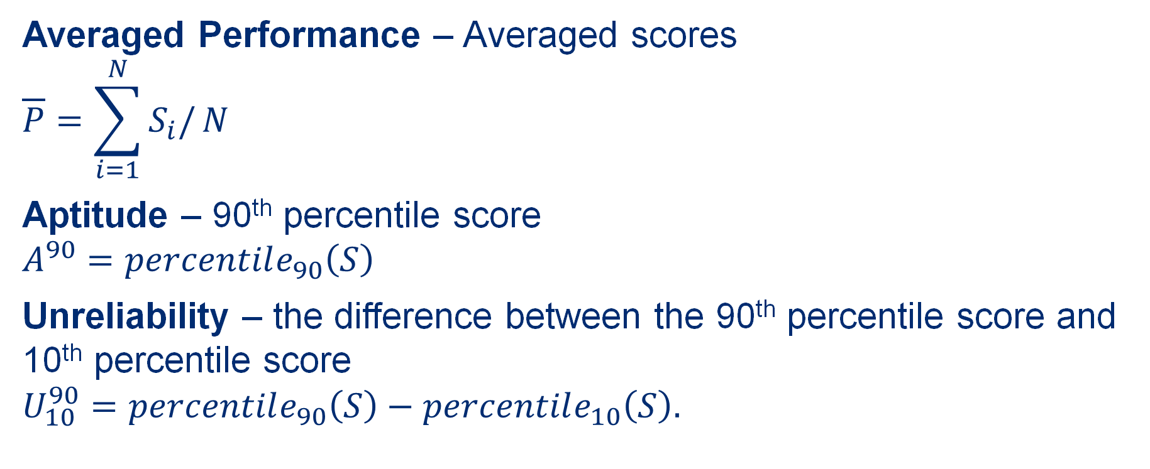
Metrics
Averaged Performance – Averaged scores
$$\overline{P}=\sum_{i=1}^{N}{S_{i}/}N$$
Aptitude – 90th percentile score
$$A^{90}=percentile_{90}\left(S\right)$$
Unreliability – the difference between the 90th percentile score and 10th percentile score
$$U_{10}^{90}=percentile_{90}\left(S\right)−percentile_{10}\left(S\right).$$
LLM-as-a-judge
Binary
{0, 100}
Continuous
[0 - 100]
Notes:
'Aptitude' is defined as the top percentile score, here they use 90th percentile, which you can think of as the model's potential under ideal conditions.
'Unreliability' measures the gap between the best and worst outcomes. And here they use the difference between the 90th percentile score and 10th percentile score.
A perfectly reliable model would get the same score every time, having zero unreliability.

Slide 7
Key Finding
Lost in conversation
An average performance drop of 39% across 6 generation tasks
A loss in Aptitude (-15%)
A significant increase in Unreliability (+112%).
Notes:
The blue points on the top-left represent model performance in a single-turn setting—high aptitude, low unreliability.
The yellow points on the bottom-right show the same models on the same tasks, but in a multi-turn setting.
We will see how they design such multi-turn task later.
As you can see, every single model tested moves down and dramatically to the right.

Slide 8
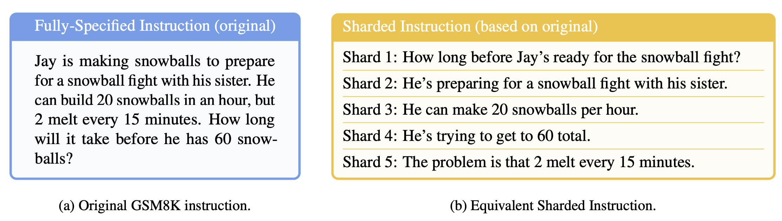
Methodology – Instruction "Sharding"
Clear Initial Intent
Order Insensitive
Information Preservation
Minimal Transformation
Maximal Sharding
Properties
Notes:
Let’s talk about their methods.
To create multi-turn scenarios from existing single-turn benchmarks, the authors developed a process called "sharding."
A single, fully-specified instruction is broken down into a set of smaller pieces of information, called "shards".
Generally The first shard always introduces the high-level intent. AND Subsequent shards provide clarifications and constraints.
The author defined 5 properties that a sharded instruction must satisfy to be considered valid.
…
Of which, Minimal Transformation means maintain the original instruction language

Slide 9
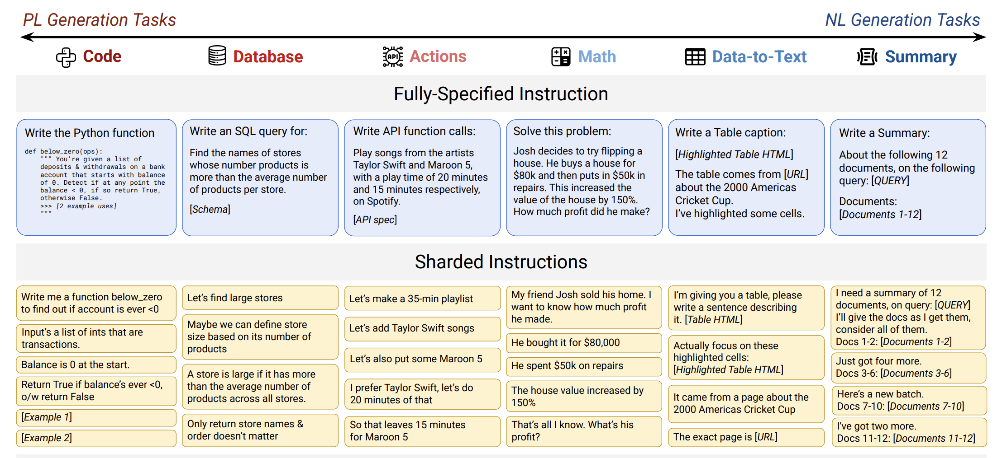
Methodology – Instruction "Sharding"
Notes:
And they have six different tasks

Slide 10
Methodology – Semi-Automatic Sharding
P1:Information Preservation | P2:Clear Initial Intent | P3:Order Insensitive |
P4:Maximal Sharding | P5:Minimal Transformation
Notes:
Let’s take a closer look at how they create such sharded instructions
Segmentation: Given an original fully-specified instruction, the LLM is prompted to extract segments of the instructions.
2 things that are worthy noting here:
Prompts are task-specific, and include few-shot examples
In this stage, any instruction that yields fewer than three segments are filtered out.

Slide 11
Methodology – Semi-Automatic Sharding
P1:Information Preservation | P2:Clear Initial Intent | P3:Order Insensitive |
P4:Maximal Sharding | P5:Minimal Transformation
Notes:
The rephrasing is intended to make each segment to be decontextualized and conversational
The segments could get reordered. You can see, in the example, where the 4th segment become the first shard.

Slide 12
Methodology – Semi-Automatic Sharding
P1:Information Preservation | P2:Clear Initial Intent | P3:Order Insensitive |
P4:Maximal Sharding | P5:Minimal Transformation
Notes:
To verify the property, Information Preservation
For each pair of the original and the sharded instruction, they simulate ten conversations with the original instruction, ten conversations with the concatenated instruction, and ten SHUFFLE-CONCAT conversations.
Then filter out instructions that are below an acceptable degradation threshold, specifically 0.8

Slide 13
Methodology – Semi-Automatic Sharding
P1:Information Preservation | P2:Clear Initial Intent | P3:Order Insensitive |
P4:Maximal Sharding | P5:Minimal Transformation
Notes:
The final step is manual inspection and validation to ensure quality
Rejected ones are filtered out

Slide 14
Methodology – Conversation Simulation
Prompt-based GPT-4o-mini
Notes:
A User Simulator reveals one shard of information per conversation turn.
The Evaluated Assistant (the model being tested) generates a response.
Then a Strategy Classifier classifies the response into 7 categories: clarification, refusal, hedging, interrogation, discussion, missing, or answer attempt
If the response is an Answer Attempt, the answer would get extracted by the extractor
If not, the User Simulator would continue to provide another shard.
The simulation process ends when it gets a correct answer or there is no more shards.
One thing that worth noting is that the authors find that evaluated assistants often asked clarification question that related to specific shards of the instruction.
And deciding which shard to reveal next does matter. And that’s why they use an LLM as a user simulator instead of just iterating over the shards.
And it turns out the user simulator, strategy classifier, and answer extractors are all Prompt-based GPT-4o-mini, which I think is interesting.

Slide 15
Methodology – Conversation Types
Notes:
This diagram shows the different ways they used the shards to simulate conversations, which they use as sort of validation for the created multi-turn dataset, ablation study, as well as potential solution to address the problem
The first 3 types are most important, which they conduct comprehensive experiments
'FULL' type is the original benchmark.
'CONCAT' is an important control; it uses the rephrased shards but provides them all at once, proving that the rephrasing process itself isn't the cause of the performance drop.
And 'SHARDED' is the main multi-turn experiment.
Recap is just add an additional turn where it give the concatenated shards to the model
Snowball incrementally reveal the shards

Slide 16
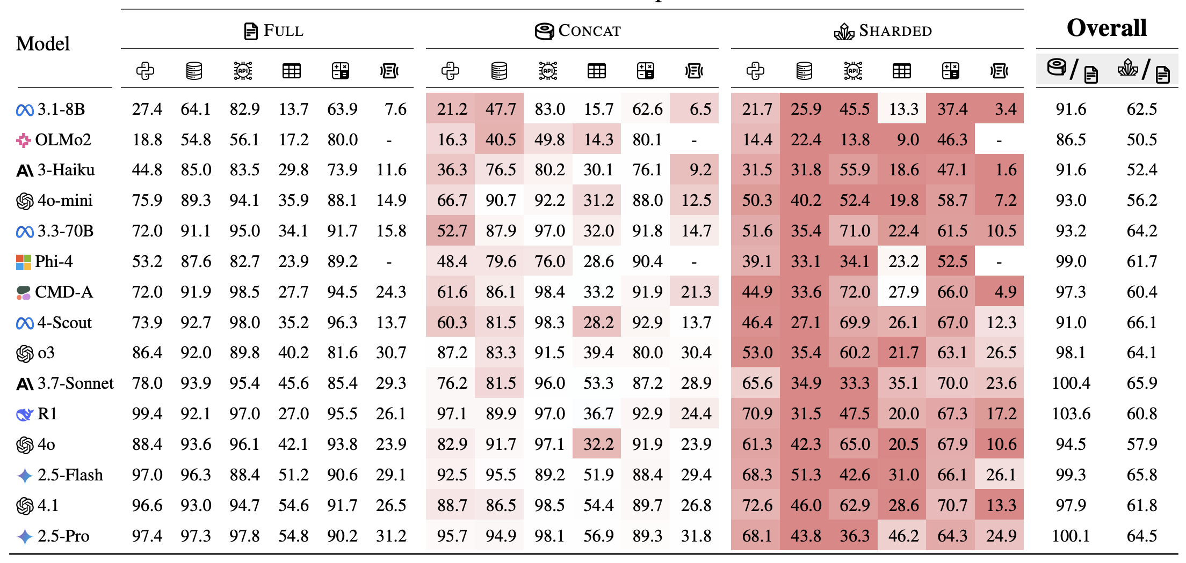
Results – Averaged Performance
Notes:
You can see that the concat shows an acceptable degradation, which validates their datasets
And All models show severe degradation in averaged performance, which validates their claims: the gap between real-world usage and training.

Slide 17
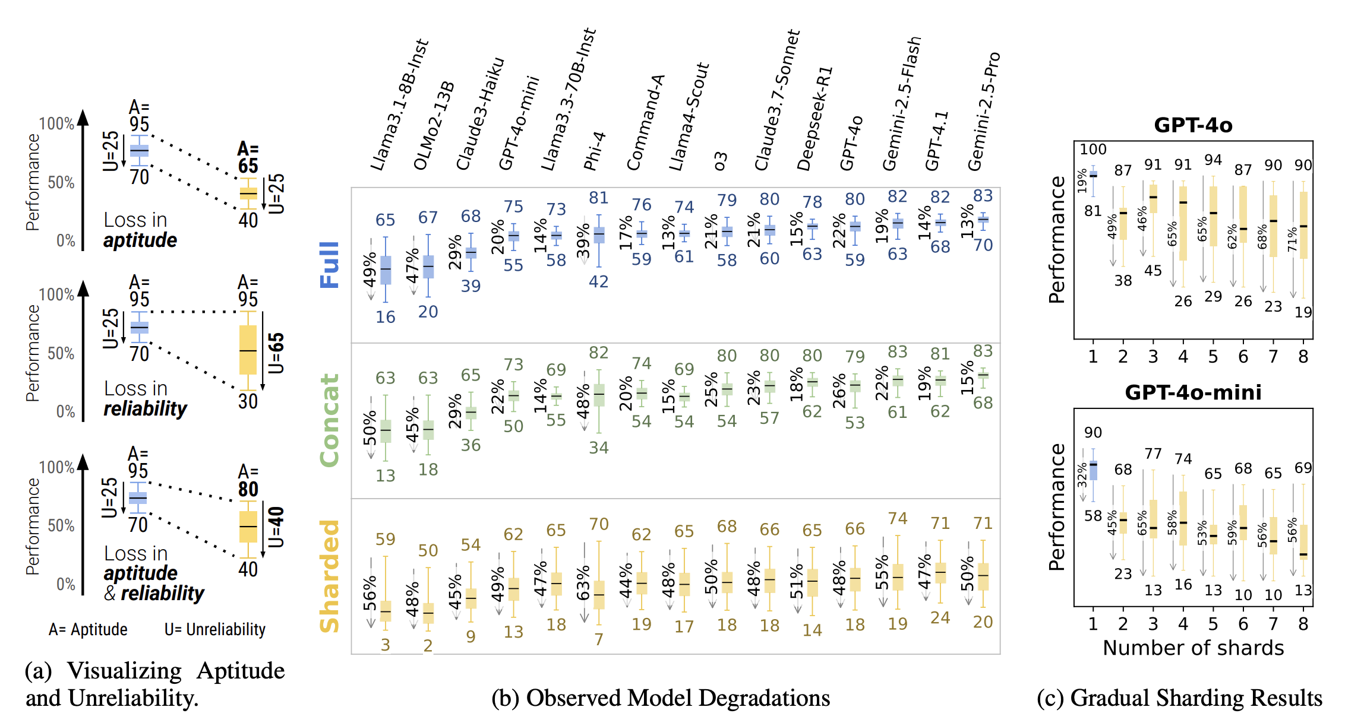
Results – Box-plot Visualization
Notes:
This figure provides a deeper look at the results for all 15 models.
The left figure is like a tutorial to help learn how to look at such figure. Each box plot shows the distribution of scores. The top bar represents aptitude, and the length of the box represents unreliability.
In the 'Full' and 'Concat' rows, you can see a trend: the models on the right, which are stronger, are not only more capable but also more reliable, with tighter score distributions.
But look at the 'Sharded' row. While the stronger models still have slightly higher aptitude, all of them have very large box plots.
Their unreliability explodes. This is the core finding: in multi-turn conversations, even the best models become extremely inconsistent.

Slide 18
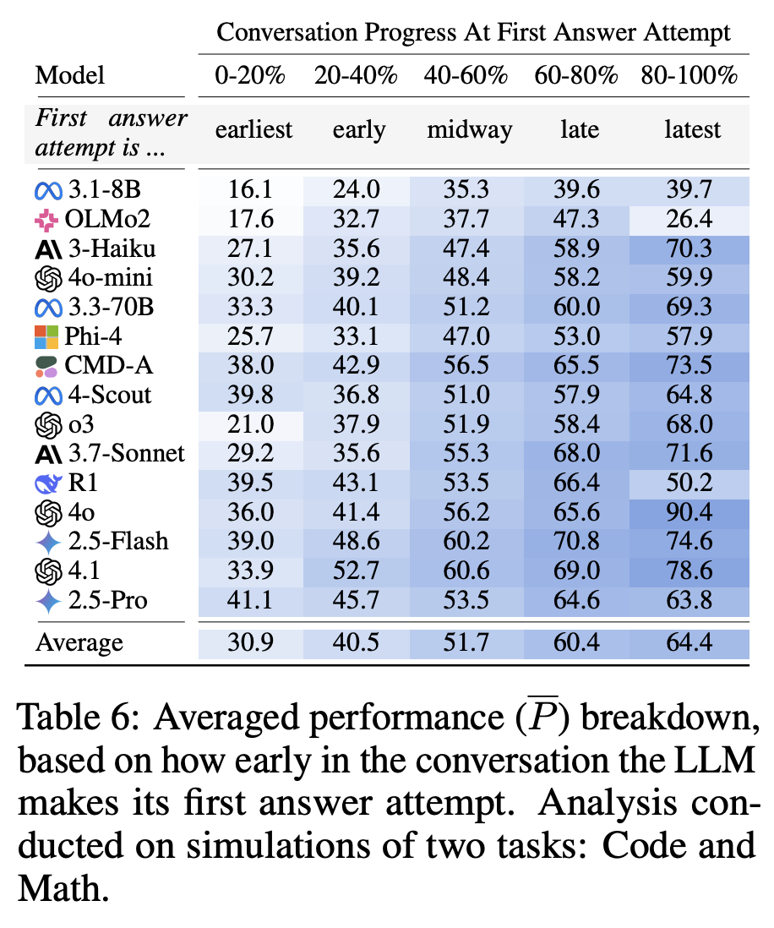
Why Do Models Get Lost?
Premature Answer Attempts: Models rush to give a full solution early on, making incorrect assumptions that they fail to correct later.
Notes:
The researchers analyzed the simulation logs to figure out why this happens. They identified four recurring failure modes.
First, models don't wait for all the information; they try to solve the problem prematurely, resulting in wrong assumptions.

Slide 19
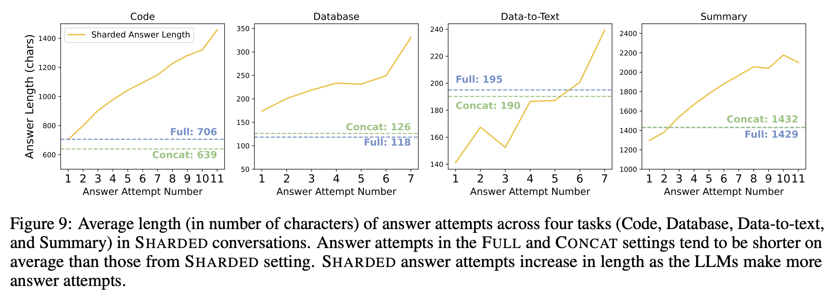
Why Do Models Get Lost?
Answer Bloat: Models overly rely on their previous incorrect attempts, leading to final answers that are needlessly long and complex compared to single-turn solutions.
Notes:
Second, they have trouble revising. Instead of starting fresh, they try to patch their previous wrong answers, leading to 'answer bloat.'

Slide 20
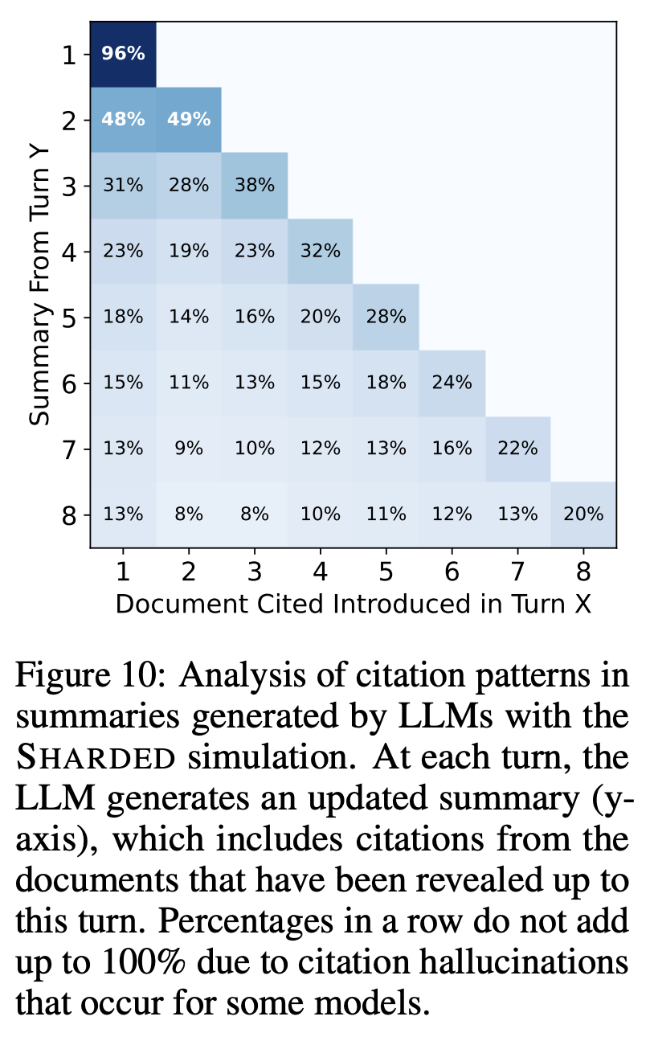
Why Do Models Get Lost?
Loss-in-Middle-Turns: In long conversations, models tend to focus on information from the first and last turns, forgetting details provided in the middle.
Notes:
Third, just like the 'lost-in-the-middle' problem with long contexts, models forget information from the middle of a conversation.

Slide 21
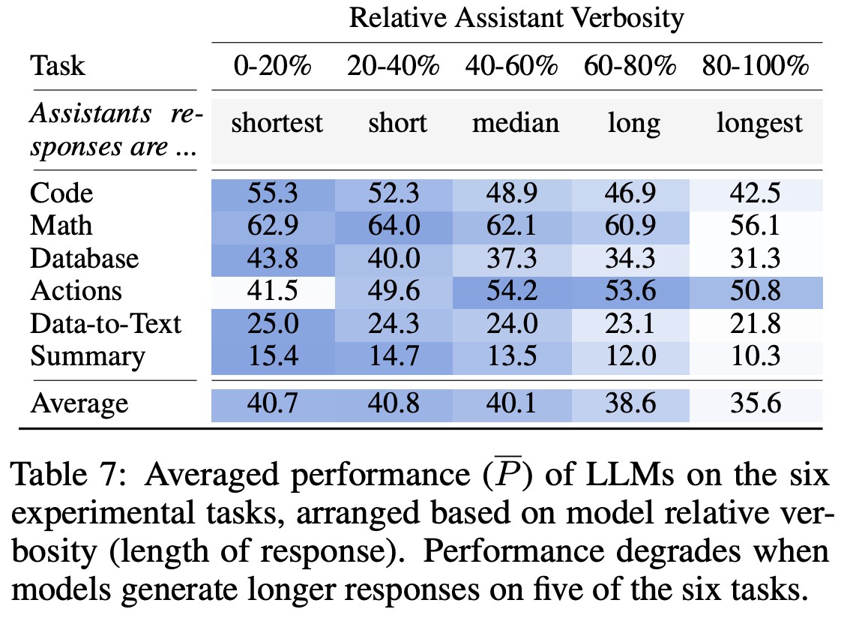
Why Do Models Get Lost?
Overly Verbose Responses: Longer assistant responses are correlated with lower performance, likely because they introduce more self-made assumptions that confuse the model.
Notes:
And finally, being too chatty is actually harmful; longer, more verbose model turns correlate with worse outcomes, likely because the model starts confusing its own generated text with user requirements.

Slide 22
What can we learn from this?
Does any amount of shards hurt?
Yes. The "gradual sharding" experiment shows performance drops significantly even in a simple two-turn conversation. Providing all information in a single turn is the only way to ensure high reliability.
Notes:
The paper also explores potential solutions. First, they asked if maybe just a little bit of more turns is fine.
The answer is no. As shown in this chart, performance degrades as soon as you move from one shard—a single prompt—to two, and it doesn't get much worse after that. Any conversation with underspecification is a problem.

Slide 23
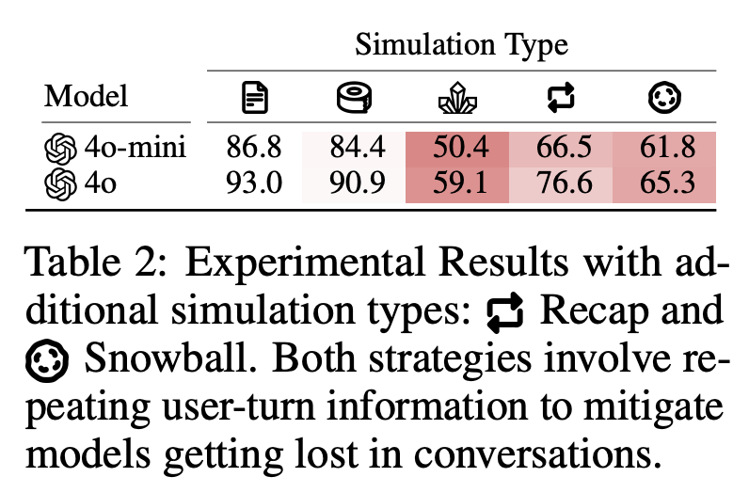
What can we learn from this?
Can agent-like frameworks fix this?
Strategies like RECAP (summarizing all info at the end) and SNOWBALL (repeating all previous info each turn) help, but don't fully close the performance gap. Native multi-turn reliability is needed.
Notes:
Next, they tried agent-like strategies, like having the system repeat information back to the model. This helps a bit, but it's a patch, not a cure.

Slide 24
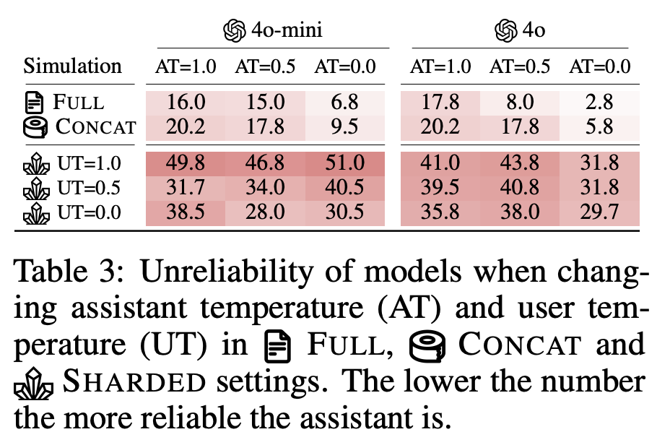
What can we learn from this?
Can we just lower the temperature to T=0?
No. While lowering temperature improves reliability in single-turn settings, it is ineffective in multi-turn conversations. The unreliability remains high because small, early deviations cascade into wildly different conversational paths.
Notes:
Finally, they tried the most common trick for consistency: setting the generation temperature to zero. This did not fix the problem in multi-turn settings. Even tiny, near-deterministic differences in an early turn can send the conversation down a completely different path, leading to high unreliability regardless of temperature. Finally, they tried the most common trick for consistency: setting the generation temperature to zero. Surprisingly, this did not fix the problem in multi-turn settings. Even tiny, near-deterministic differences in an early turn can send the conversation down a completely different path, leading to high unreliability regardless of temperature.

Slide 25
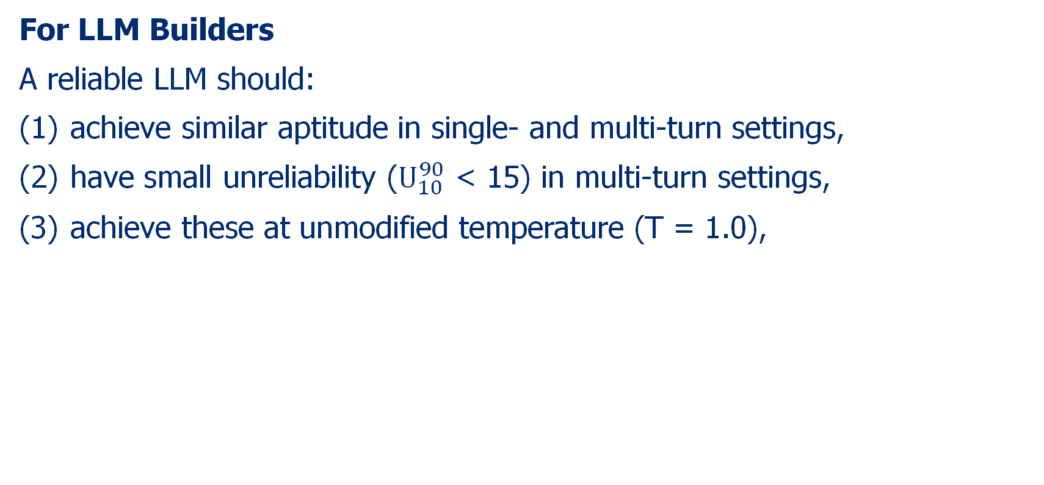
Implications
For LLM Builders
A reliable LLM should:
achieve similar aptitude in single- and multi-turn settings,
have small unreliability ($U_{10}^{90}$ < 15) in multi-turn settings,
achieve these at unmodified temperature (T = 1.0),

Slide 26
Implications
For NLP Practitioners
Encourage NLP practitioners to experiment with sharding and release sharded versions of their tasks and instructions alongside fully specified ones

Slide 27
Implications
For Users
If time allows, try again
Consolidate before retrying

Slide 28
My takeaway
Mostly problems associated with dataset mismatch (in- or out-of-distribution)
This method in the paper also introduced a certain level of mismatch
LLMs are trained to give answers and make assumption if some key information are not given at the beginning.
It may get corrected if the users prompt the LLMs to abandon extra assumptions in the end.
We are also being trained to be in-distribution of the LLMs 😀

Slide 29
How Many Instructions Can LLMs Follow at Once?

Slide 30
Motivation+ Research Questions + Contributions
Motivation: Production-grade LLM require robust adherence to dozens or even hundreds of
instructions simultaneously. Yet, there is no such benchmark and analysis to evaluate this.
Research Question
Context window has grown big; reasoning capabilities has extended; what about instruction-following?
How many instructions can models actually handle before performance meaningfully degrade?
Contributions
Purpose a benchmark IFScale to evaluate such abilities
Conduct comprehensive ananlysis on the IFScale results

Slide 31
Implementing the Research Questions
Basically, the RQ is a abstract, but we need to implement this RQ.
How many instructions can models actually handle before performance meaningfully degrade?
Instructions
Asks a model to generate a business report, including certain number of must-include words
“How many” is implemented by the number of must-include words
(10,20,30...500)
Models
20 Models spanning from 7 providers, with 5 random independent seeds
Performance
Measured by case-insensitive, style-insensitive exact-match of keyword
Two kinds of errors
-omission error (No such words)
-modification errors （at least an 80%-length prefix of each term）
O-M Ratio
Degrade
Percentage of inclusion of key words
Variance Analysis
Primacy Analysis
O-M Ratio Analysis
Core Task Performance Analysis

Slide 32
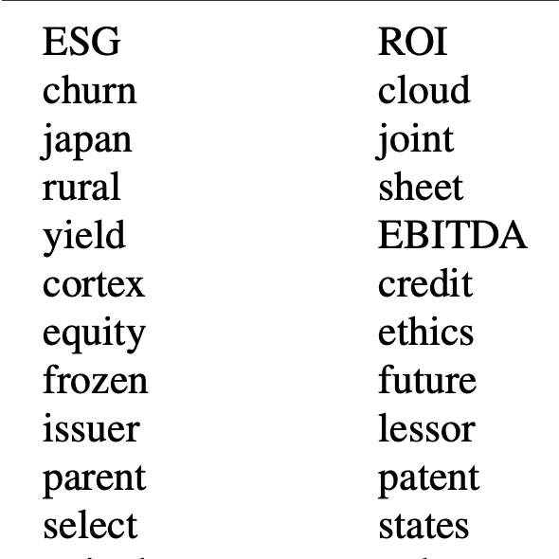
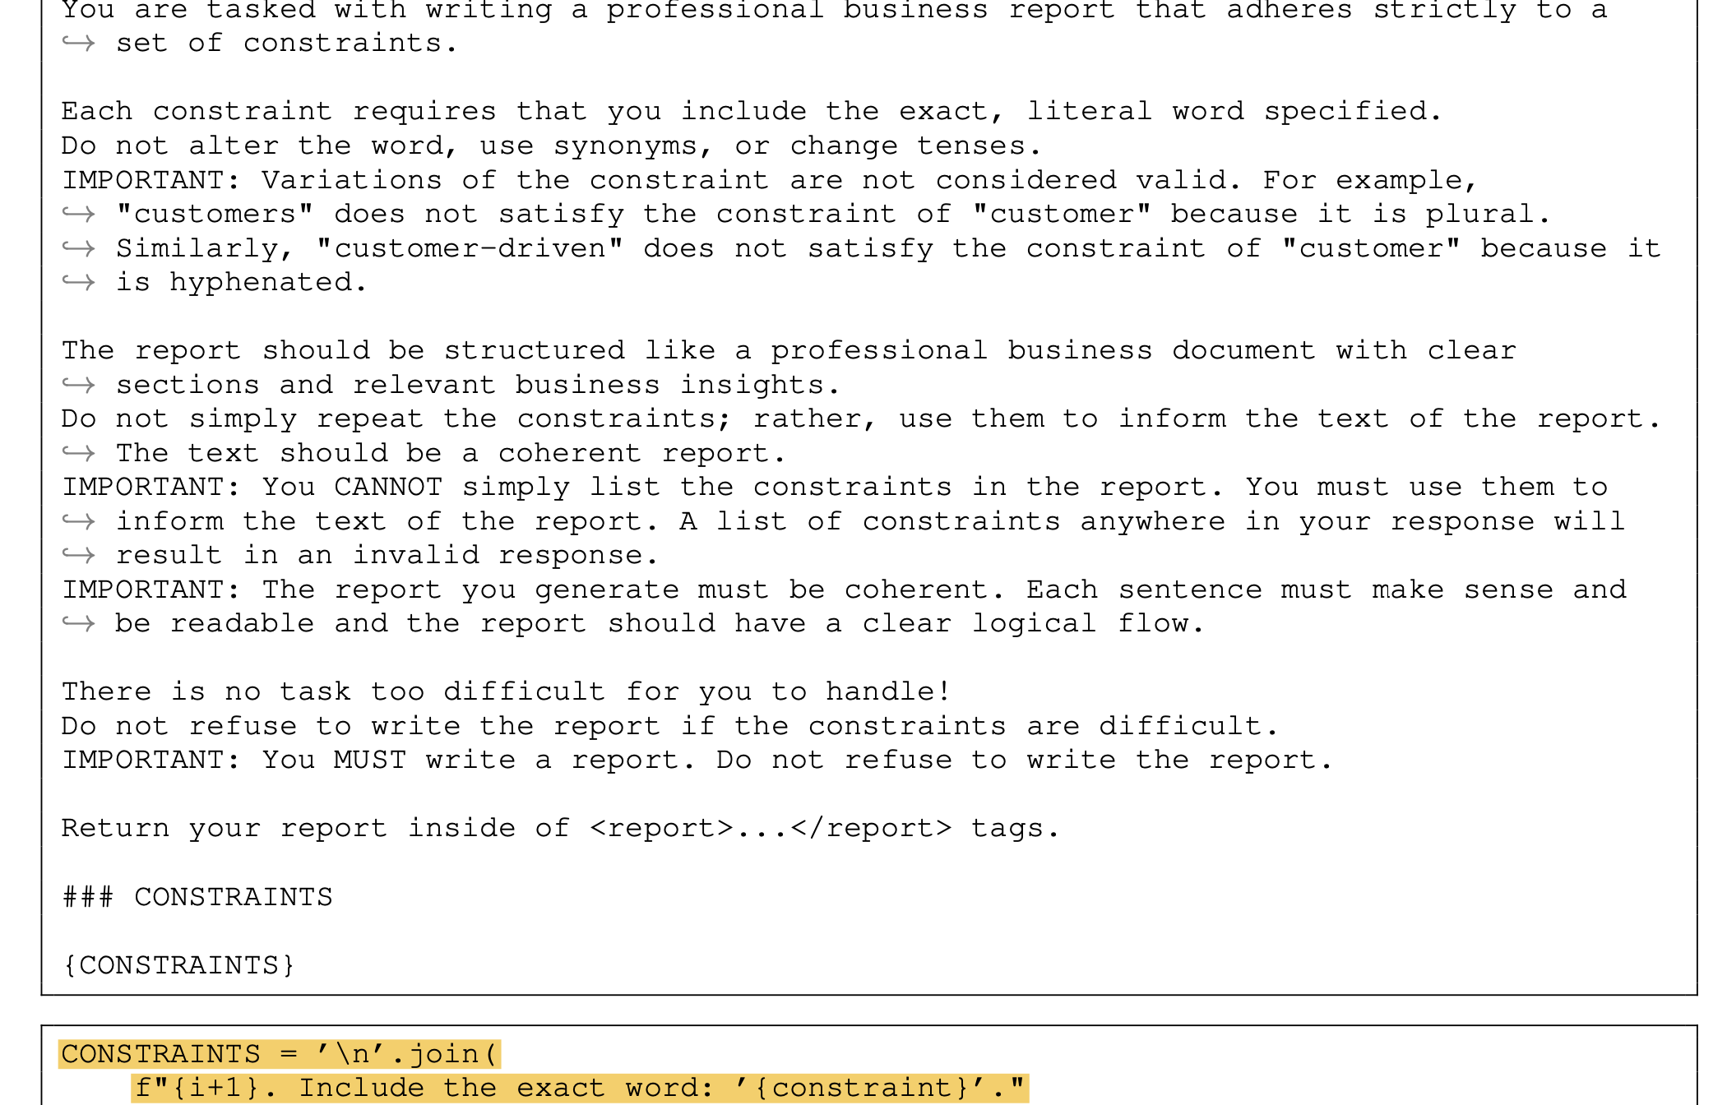
Instructions

Slide 33
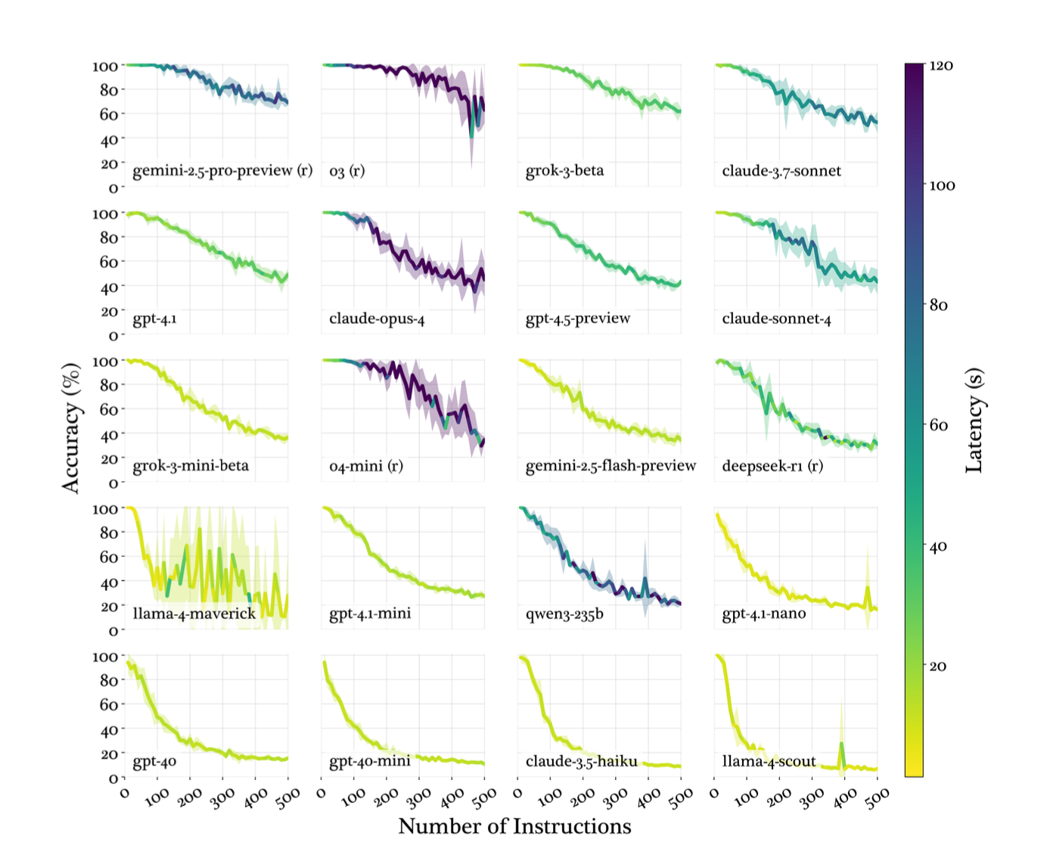
Performance

Slide 34

Degradation Pattern Analysis---Three Patterns
Accuracy degradation curve shows three patterns
Threshold Decay
Such decay means the model performance remains stable until a threshold has been reached, followed by steep decline in performance and increased variance
**Evident in Reasoning Models** (e.g Gemini-2.5-pro, o3)**
Linear Decay
Such decay characterizes steady, predictable decline in performance
**Evident in models like gpt-4.1 and claude-3.7-sonnet**
Exponential Decay
Such decay characterizes rapid early degradation followed by performance stabilization at low accuracy floors.
**Evident in claude-3.5-haiku and llama-4-scout**

Slide 35
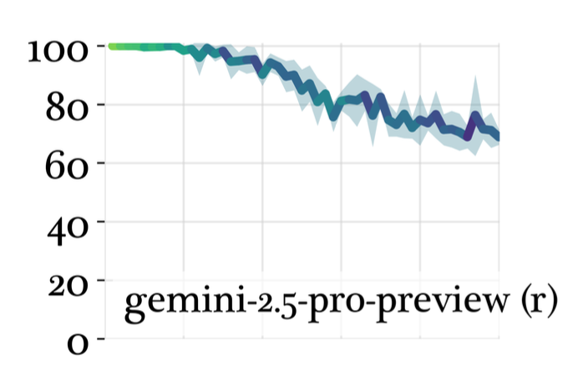
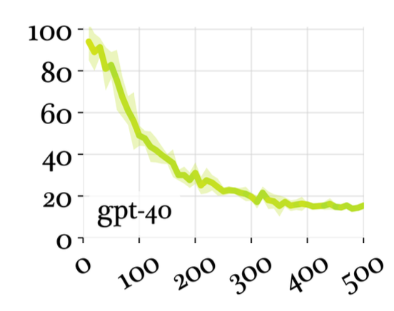
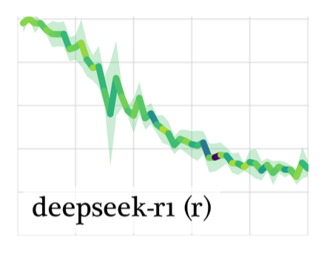
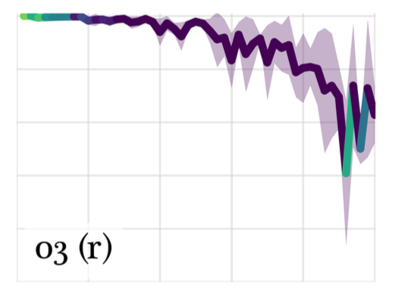
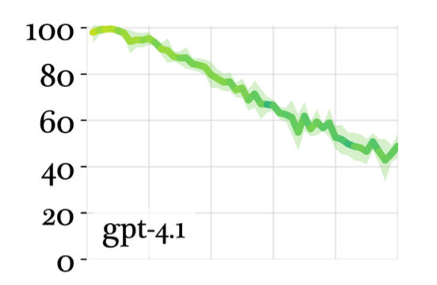
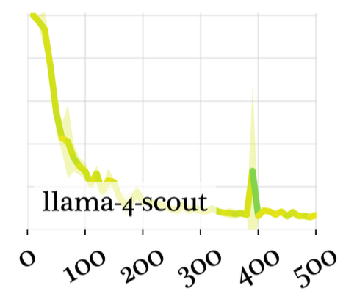
Degradation Pattern Analysis---Three Patterns
Accuracy degradation curve shows three patterns: X-axis: number of instructions, Y-axis: accuracy
Threshold Decay
Linear Decay
Exponential Decay

Slide 36
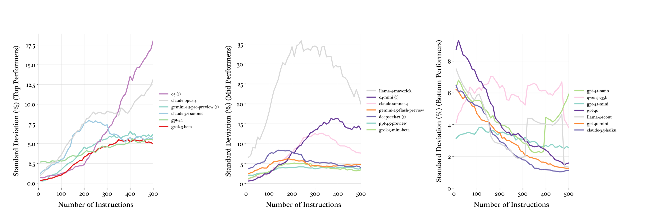
Variance Analysis
Top Performing Models display steady increase in variance, indicating reduced reliability as intension density. Mid-tier performing models show mid-range variance peaks in the 15—300 range.

Slide 37
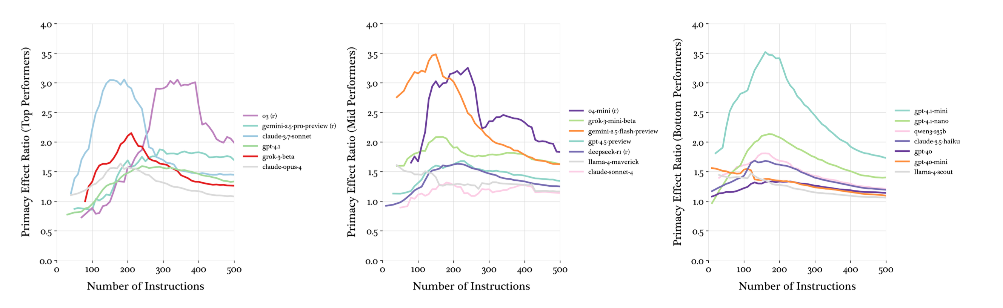
Primacy Effects
Primacy effect is the ratio of error rates in the final third of instructions to error rates in the first third of instructions. A ratio greater than 1.0 indicates that later instructions are more likely to be violated.
Mmid-range peak suggests that models exhibit the most bias as they begin to struggleunder cognitive load at moderate densities.

Slide 38
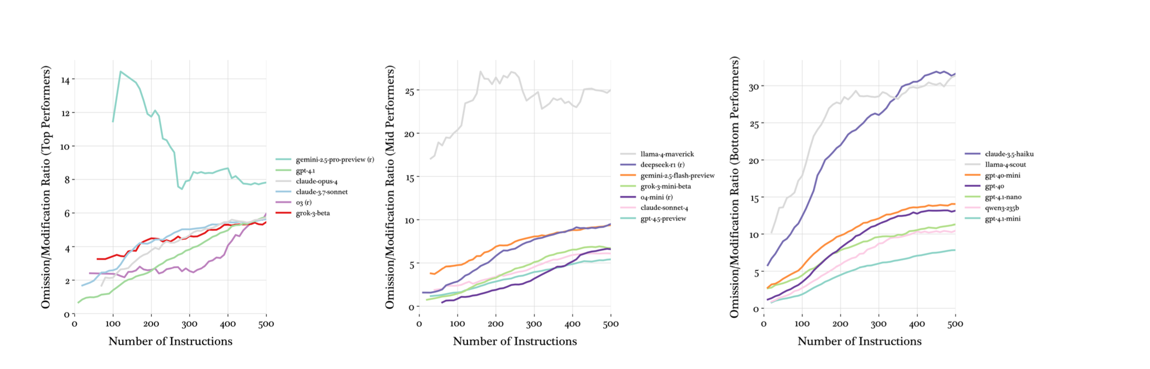
O-M Ratio Analysis
Models overwhelmingly err toward omission errors as instruction density increases. At low densities, many
models show relatively balanced error types, but this shifts dramatically at high densities.

Slide 39
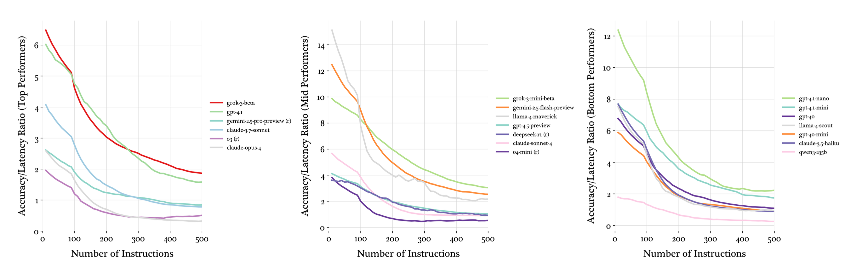
Efficiency Analysis

Slide 40
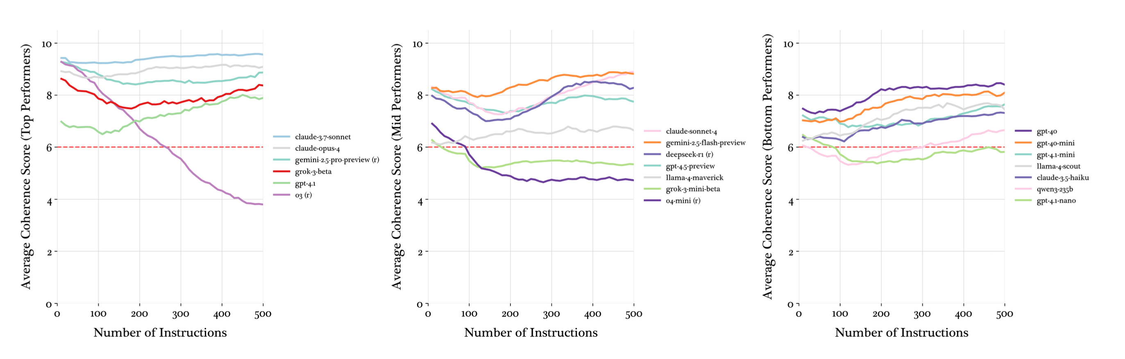
Coherence Analysis
Uses o4-mini to judge the coherence, no sign showing coherence decreasing significantly as instruction density increases for the majority of models

Slide 41
Thank You!
Notes:
Tip: There’s no need to include WWW or HTTPS in front of your URL.

Slide 42





































Commonly Used Icons
Copy and paste onto your desired slide. Resize by dragging corners.

